Slide 1
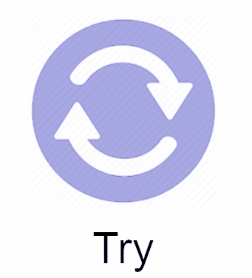
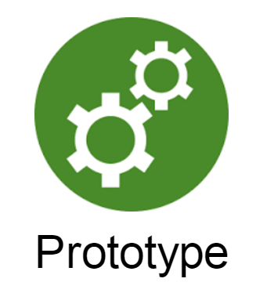
Design Thinking
A very quick overview
Friday, May 19, 2017
Empathize
Define
Try
Imagine

Slide 2
Welcome!
Introductions
Cranbrook MIT Collaboration
Workshop Overview
Fast Paced!
Introduction to Design Thinking
Doing Design Thinking
All in 3 hours!

Slide 3
The Design Thinking Process is...
...A tool that many businesses use to solve complex problems. There has been a lot of “buzz” because schools have been adapting the process for:
teachers and administrators to examine challenges
students to learn and apply to a full range of challenges
The Design Thinking process is:
Messy (non-linear and adaptable)
Fast-Paced (fail often; fail fast)
A process - we get better each time we use it!

Slide 4
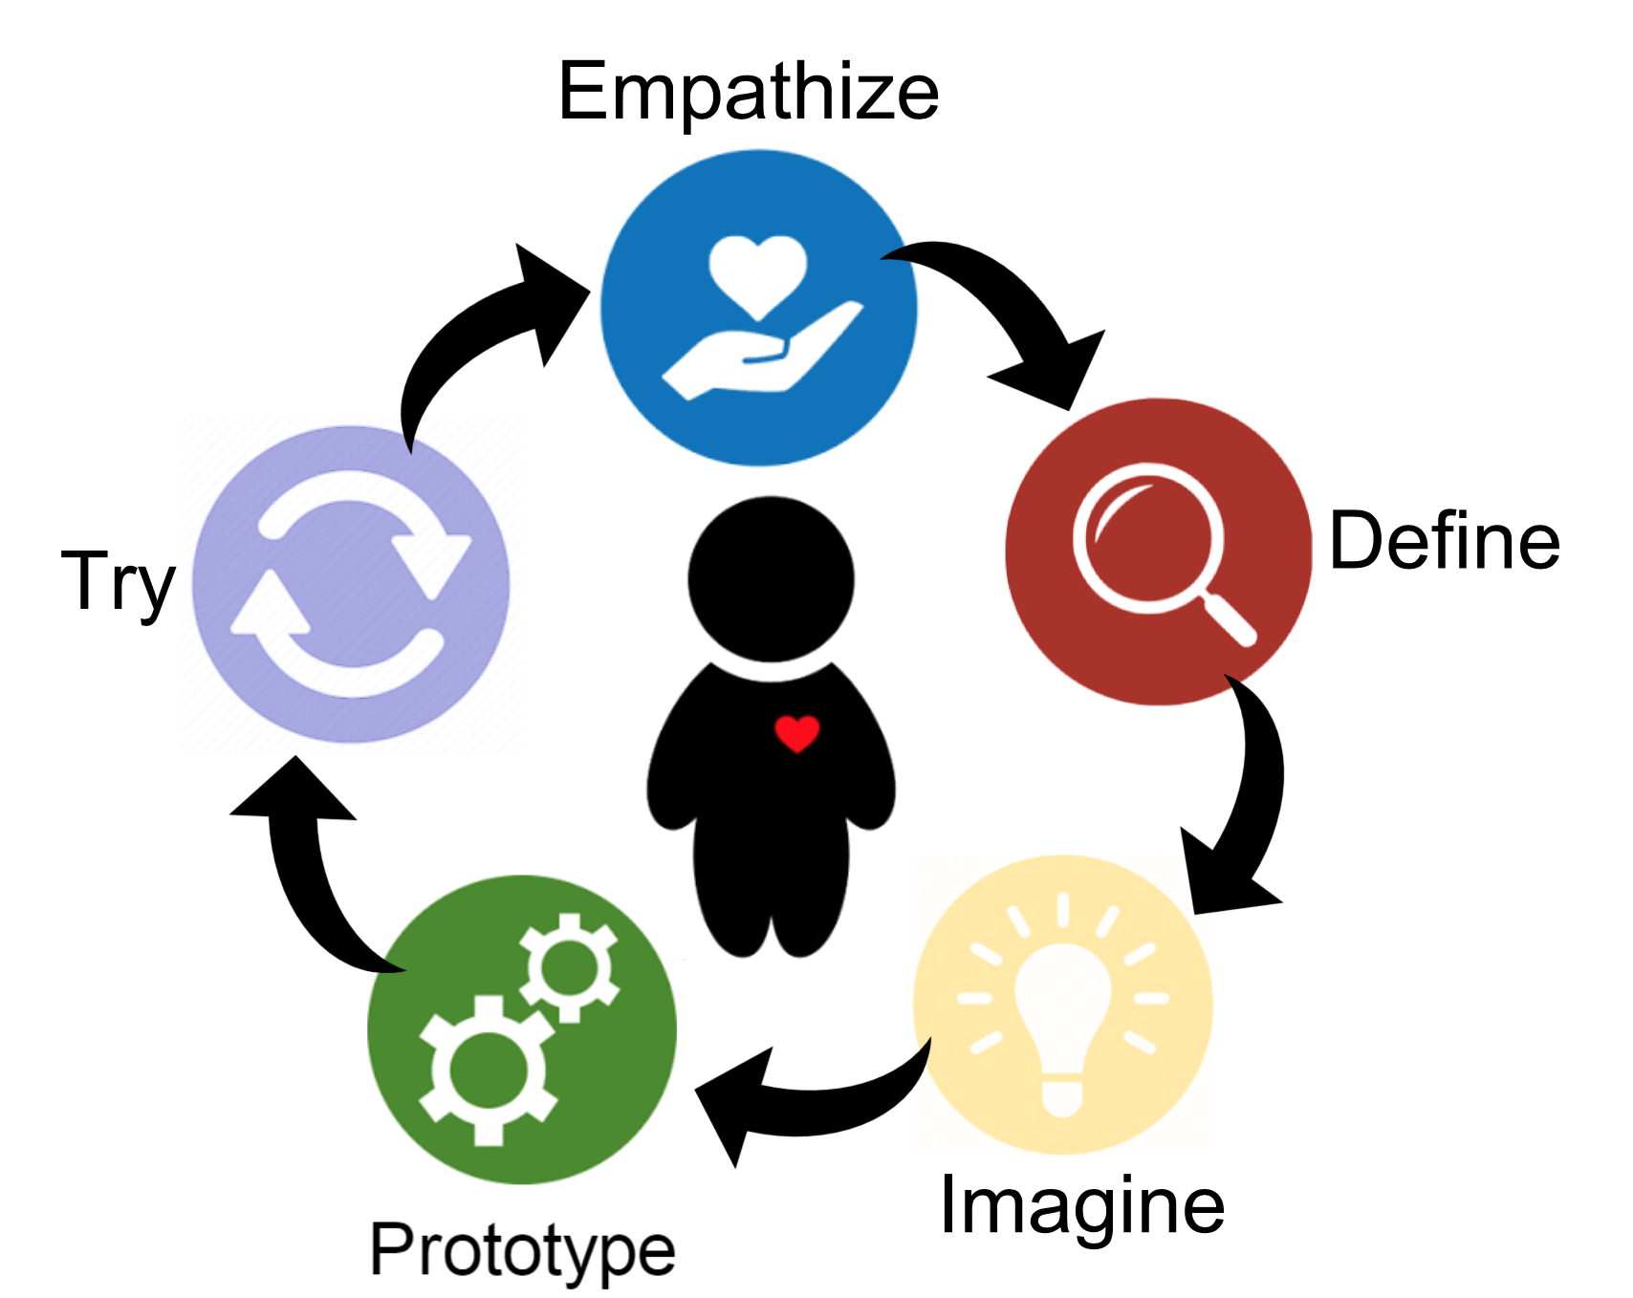
Quick Talk: What is Design Thinking?
Notes:
Overview of the process - steps often skipped in pbl - user and prototype

Slide 5
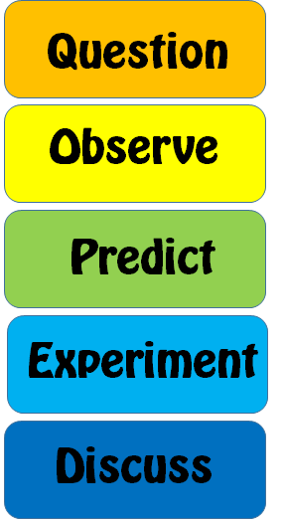
Quick Talk: What is Design Thinking?
Notes:
Overview of the process - steps often skipped in pbl - user and prototype

Slide 6
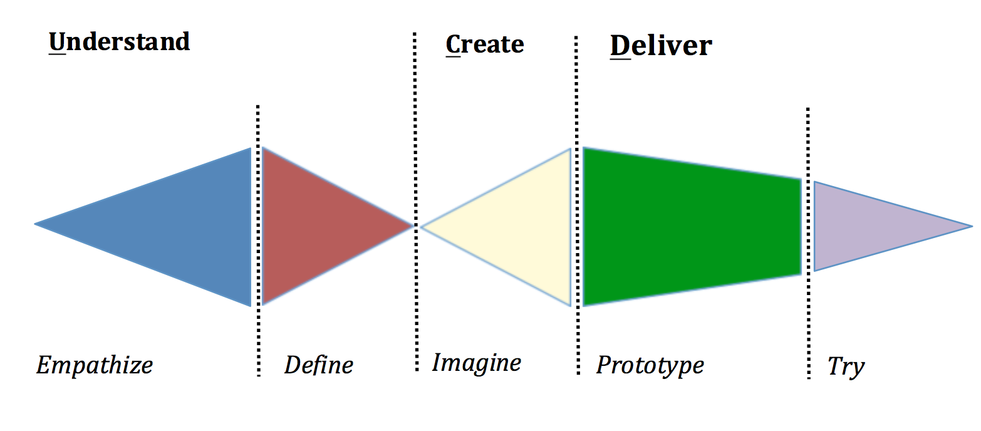
Quick Talk: What is Design Thinking?

Slide 7
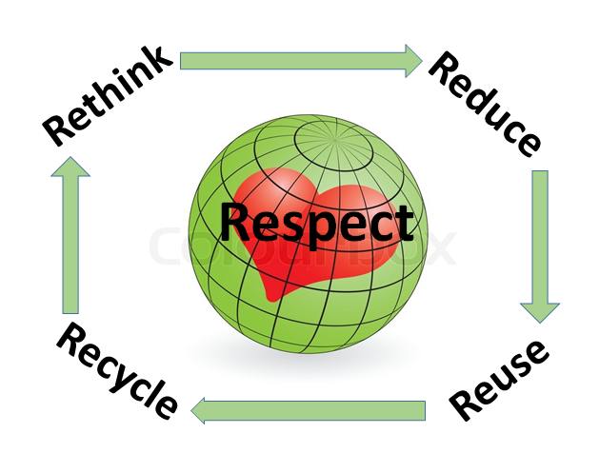
Today’s Challenge
How might we design a classroom that supports one or all of the 5 R’s?

Slide 8
Empathize

Slide 9
Stage 1: Empathize
What is the empathize stage?
Empathy Map
Interview

Slide 10
What is the Empathize Stage?
This first step is a key foundation and sets the course for the remaining stages.
Design thinkers seek to build empathy with those facing the problem and fully understand the “user.”
Ensures solution is about the user and not about the designer (avoid “I know what you need!”)
Tools: Interview and Observe

Slide 11
How to Empathize
Observe.
View users and their behaviors in the context of their lives.
Notice any disconnects between what someone says and what s/he does.
Engage.
Get people to tell stories; have a conversation.
Listen. Listen More!
Ask questions and simply listen
We often are thinking about our response or what we think instead of just listening.
Gather as much information as you can.
Empathize
“To create meaningful innovations, you need to know your users and care about their lives.”
WHAT is the Empathize mode
HOW to empathize
To empathize, you:
In empathy work, connect with people and seek stories
Empathy is the centerpiece of a human-centered design process. The Empathize mode is the work you
do to understand people, within the context of your design challenge. It is your
effort to understand the way they do things and why, their physical and emotional needs, how they
think about world, and what is meaningful to them.
WHY empathize
As a design thinker, the problems you are trying to solve are rarely your own—they are those of a
particular group of people; in order to design for them, you must gain empathy for who they are and
what is important to them.
Observing what people do and how they interact with their environment gives you clues about what
they think and feel. It also helps you learn about what they need. By watching people, you can
capture physical manifestations of their experiences – what they do and say. This will allow you to
infer the intangible meaning of those experiences in order to uncover insights.
These insights give you direction to create innovative solutions. The best solutions come out of
the best insights into human behavior. But learning to recognize those insights is harder than you
might think. Why? Because our minds automatically filter out a lot of information without our even
realizing it. We need to learn to see things “with a fresh set of eyes,” and empathizing is what
gives us those new eyes.
- Observe. View users and their behavior in the context of their lives. As much as possible do
observations in relevant contexts in addition to interviews. Some of the most powerful realizations
come from noticing a disconnect between what someone says and what he does.
Others come from a work-around someone has created which may be very surprising to you as the
designer, but she may not even think to mention in conversation.
- Engage. Sometimes we call this technique ‘interviewing’ but it should really feel more like a
conversation. Prepare some questions you’d like to ask, but expect to let the conversation deviate
from them. Keep the conversation only loosely bounded. Elicit stories from the
people you talk to, and always ask “Why?” to uncover deeper meaning. Engagement can come through
both short ‘intercept’ encounters and longer scheduled conversations.
- Watch and Listen. Certainly you can, and should, combine observation and engagement. Ask someone
to show you how they complete a task. Have them physically go through the steps, and talk you
through why they are doing what they do. Ask them to vocalize what’s
going through their mind as they perform a task or interact with an object. Have a conversation in
the context of someone’s home or workplace – so many stories are embodied in artifacts.
Use the environment to prompt deeper questions.
Empathize
Define
Engaging with people directly reveals a tremendous amount about the way they think and the values
they hold. Sometimes these thoughts and values are not obvious to the people who hold them, and a
good conversation can surprise both the designer and the subject by the unanticipated insights that
are revealed. The stories that people tell and the things that
people say they do—even if they are different from what they actually do—are strong indicators of
their deeply held beliefs about the way the world is. Good designs are built on a solid
understanding of these beliefs and values.
Transition: Empathize >> Define
Unpack: When you move from empathy work to drawing conclusions from that work, you need to process
all the things you heard and saw in order to understand the big picture and grasp the takeaways of
it all. Unpacking is a chance to start that process – sharing what you found with fellow designers
and capturing the important parts in a visual form. Get all the information out of your head and
onto a wall where you can start to make connections—post pictures of your user, post-its with
quotes, maps of journeys or experiences—anything that captures impressions and information about
your user. This is the beginning of the synthesis process, which leads into a ‘Define’ mode.
Empathize
“To create meaningful innovations, you need to know your users and care about their lives.”
WHAT is the Empathize mode
HOW to empathize
To empathize, you:
In empathy work, connect with people and seek stories
Empathy is the centerpiece of a human-centered design process. The Empathize mode is the work you
do to understand people, within the context of your design challenge. It is your
effort to understand the way they do things and why, their physical and emotional needs, how they
think about world, and what is meaningful to them.
WHY empathize
As a design thinker, the problems you are trying to solve are rarely your own—they are those of a
particular group of people; in order to design for them, you must gain empathy for who they are and
what is important to them.
Observing what people do and how they interact with their environment gives you clues about what
they think and feel. It also helps you learn about what they need. By watching people, you can
capture physical manifestations of their experiences – what they do and say. This will allow you to
infer the intangible meaning of those experiences in order to uncover insights.
These insights give you direction to create innovative solutions. The best solutions come out of
the best insights into human behavior. But learning to recognize those insights is harder than you
might think. Why? Because our minds automatically filter out a lot of information without our even
realizing it. We need to learn to see things “with a fresh set of eyes,” and empathizing is what
gives us those new eyes.
- Observe. View users and their behavior in the context of their lives. As much as possible do
observations in relevant contexts in addition to interviews. Some of the most powerful realizations
come from noticing a disconnect between what someone says and what he does.
Others come from a work-around someone has created which may be very surprising to you as the
designer, but she may not even think to mention in conversation.
- Engage. Sometimes we call this technique ‘interviewing’ but it should really feel more like a
conversation. Prepare some questions you’d like to ask, but expect to let the conversation deviate
from them. Keep the conversation only loosely bounded. Elicit stories from the
people you talk to, and always ask “Why?” to uncover deeper meaning. Engagement can come through
both short ‘intercept’ encounters and longer scheduled conversations.
- Watch and Listen. Certainly you can, and should, combine observation and engagement. Ask someone
to show you how they complete a task. Have them physically go through the steps, and talk you
through why they are doing what they do. Ask them to vocalize what’s
going through their mind as they perform a task or interact with an object. Have a conversation in
the context of someone’s home or workplace – so many stories are embodied in artifacts.
Use the environment to prompt deeper questions.
Empathize
Define
Engaging with people directly reveals a tremendous amount about the way they think and the values
they hold. Sometimes these thoughts and values are not obvious to the people who hold them, and a
good conversation can surprise both the designer and the subject by the unanticipated insights that
are revealed. The stories that people tell and the things that
people say they do—even if they are different from what they actually do—are strong indicators of
their deeply held beliefs about the way the world is. Good designs are built on a solid
understanding of these beliefs and values.
Transition: Empathize >> Define
Unpack: When you move from empathy work to drawing conclusions from that work, you need to process
all the things you heard and saw in order to understand the big picture and grasp the takeaways of
it all. Unpacking is a chance to start that process – sharing what you found with fellow designers
and capturing the important parts in a visual form. Get all the information out of your head and
onto a wall where you can start to make connections—post pictures of your user, post-its with
quotes, maps of journeys or experiences—anything that captures impressions and information about
your user. This is the beginning of the synthesis process, which leads into a ‘Define’ mode.

Slide 12
Empathy Map: Who is the user….?
USER NAME
Title or Role
Seeing
Hearing
Thinking
Saying
Feeling
Doing

Slide 13
Learning how to interview
It’s not easy - it’s a skill!
Prepare a few questions in advance
Ask
Why X 5
Tell me more about….
The other 4 W’s
Utilize Empathy Map (how did you feel? What did you see?)
Listen, Listen, Listen

Slide 15
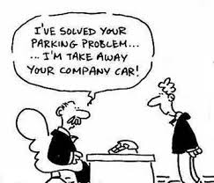
Stage 2: Define
What is the define stage?
Needs and Insights
How Might We…?

Slide 16
What is the Define Stage?
Put together all of the information you gathered in the empathize stage.
Synthesize your observations.
What are the core problems/challenges you identified?
What are the unexpected problems/challenges that surprised you?
Tools: User/Needs/Insights

Slide 17
How To Define
Organize.
Reflect on all of the information you discovered
Synthesize.
What are the common themes you discovered in the Empathize Stage?
Make Sense of the Data.
What are the core problems/challenges you identified?
What surprised you?
Narrow information down to a “How Might We” statement.
Notes:
What’s the user seeing, saying, doing etc, not from the designer’s perspective

Slide 18
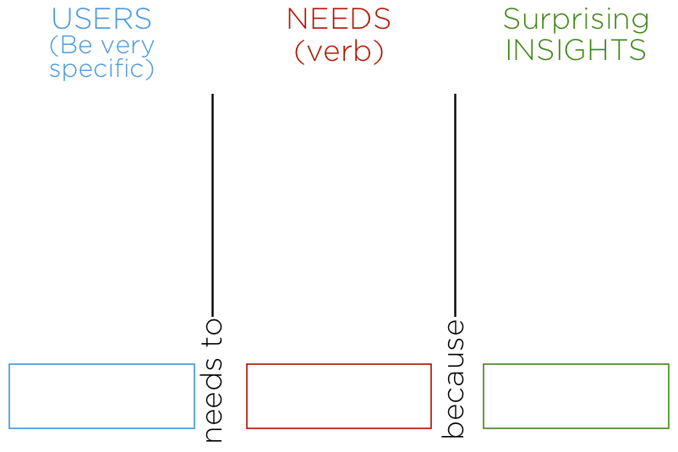
Define - needs statement
As many users as possible.
Be SPECIFIC
Verbs (activities and desires with which your user could use help)
NOT nouns (solutions)
Observation + Intuition
A remarkable realization
Might grown from contradiction between user experiences
Ask yourself “WHY” when you notice something unusual
Notes:
Needs don’t need to correspond with an insight. It’s a place to capture needs and insights seperately.

Slide 19
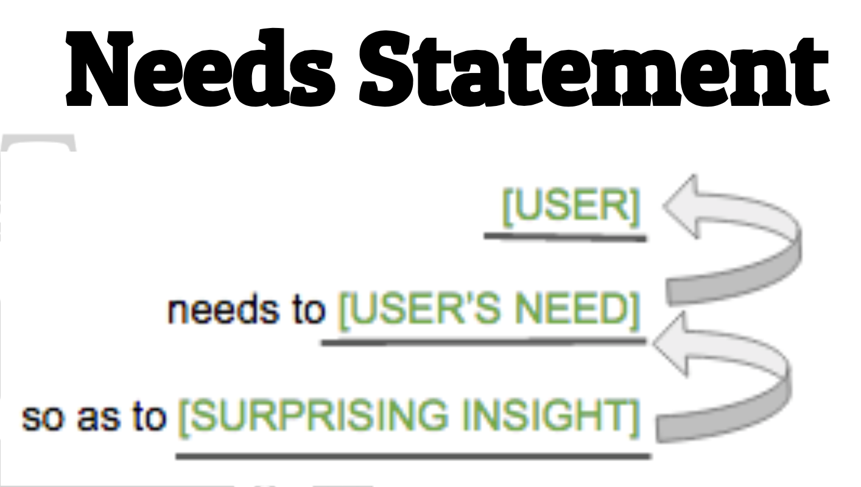
Define - needs statement
Needs Statement.
Human Centered.
Broad enough for creative freedom.
Narrow enough to make it manageable.
“How Might We…” statement!
Notes:
Human-centred. This requires you to frame your problem statement according to specific users, their needs and the insights that your team has gained in the Empathise phase. The problem statement should be about the people the team is trying to help, rather than focussing on technology, monetary returns or product specifications.
Broad enough for creative freedom. This means that the problem statement should not focus too narrowly on a specific method regarding the implementation of the solution. The problem statement should also not list technical requirements, as this would unnecessarily restrict the team and prevent them from exploring areas that might bring unexpected value and insight to the project.
Narrow enough to make it manageable. On the other hand, a problem statement such as , “Improve the human condition,” is too broad and will likely cause team members to easily feel daunted. Problem statements should have sufficient constraints to make the project manageable.

Slide 21
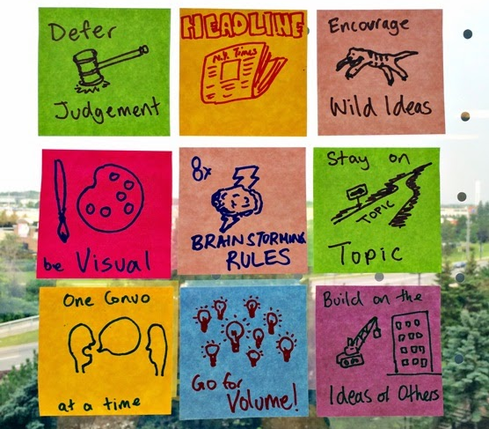
Stage 3: Imagine
What is the imagine stage?
Visual Thinking
Brainstorming

Slide 22
What is the Imagine Stage?
Get creative!
Quantity over quality (generate as many ideas as possible).
Defer Judgement or criticism.
Encourage weird, wacky and wild ideas.
Build off of each other.
Stay focused on the topic
One conversation at a time.
Be visual.

Slide 23
How To Imagine
Brainstorm!
Many brainstorm techniques.
Generate as many ideas as possible.
Step beyond obvious solutions
Get those obvious solutions out of your head!
Perspectives and strength of team members.

Slide 24
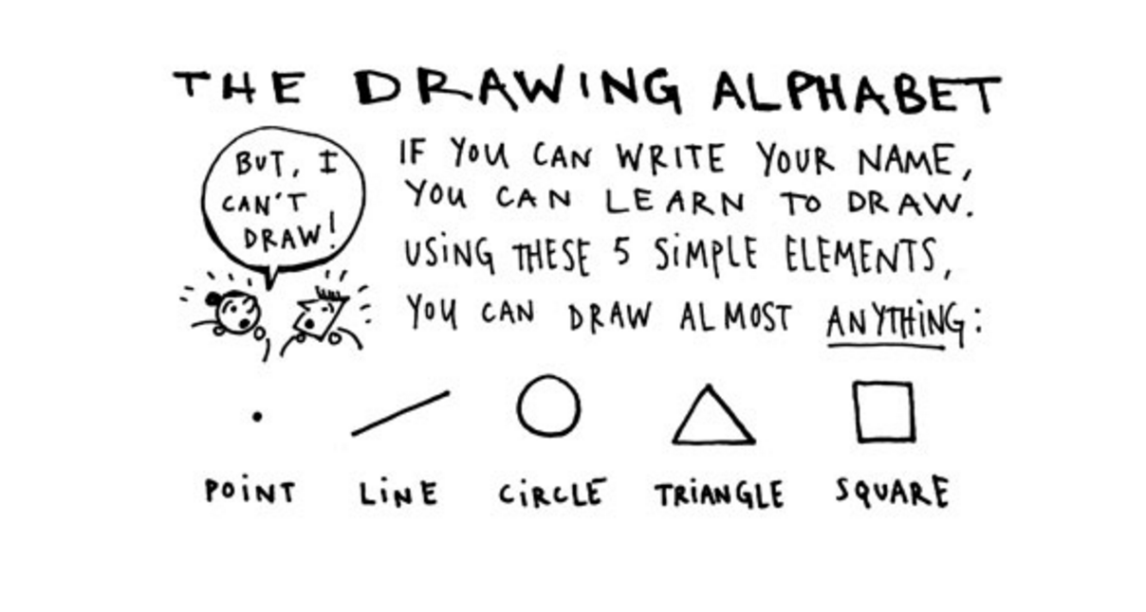
Visual Brainstorming

Slide 25
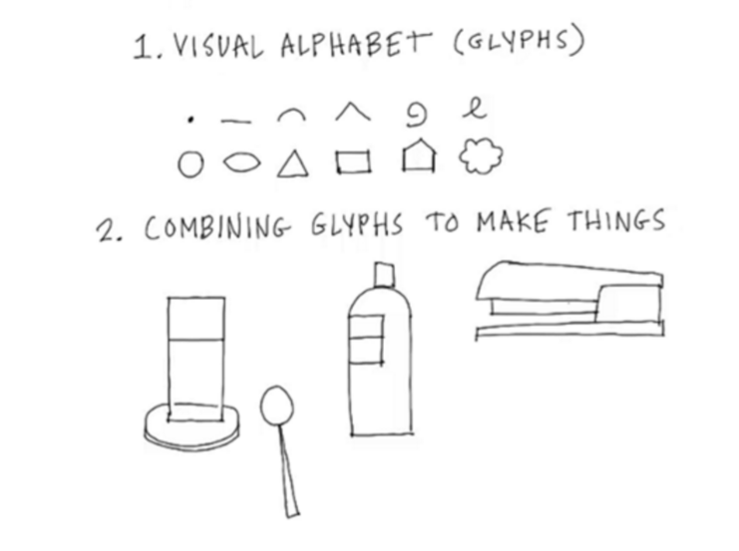
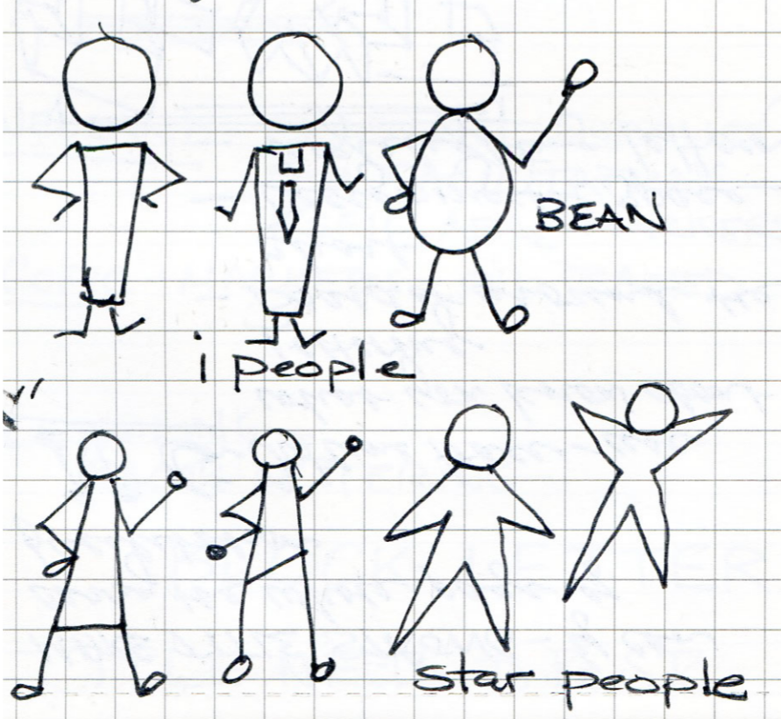
Visual Brainstorming

Slide 26
How To Imagine
Brainstorm!
Many brainstorm techniques.
Generate as many ideas as possible.
Step beyond obvious solutions.
Get those obvious solutions out of your head!
Perspectives and strength of team members.
Select Ideas.
Collect, categorize, refine, narrow down.

Slide 27
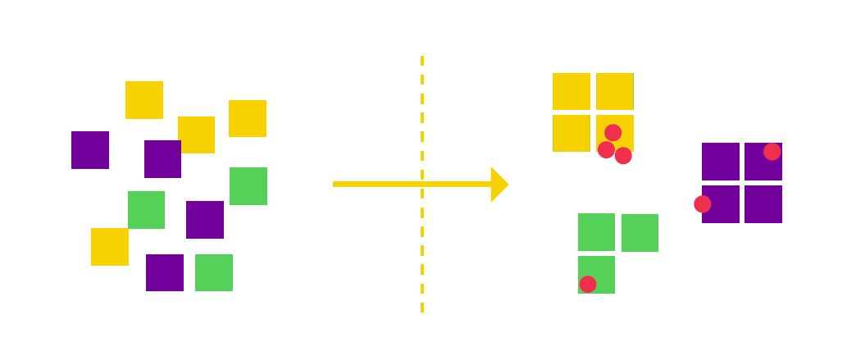
Imagine - group and vote
Group similar concepts and individually vote for your top 3 favorites to PROTOTYPE

Slide 29
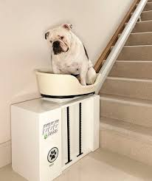
Stage 4: Prototype
What is the prototype stage?
Make it, build it

Slide 30
What is the Prototype Stage?
Experimental stage focused on identifying the best possible solution.
Produce a number of inexpensive, scaled-down versions of the product or features of the product.
Work with what you have around you.
Three major components:
Creating experience/product
Getting feedback
Iterating

Slide 31
How to Prototype - Fail Often, Fail Early
THE FASTER YOU MAKE, THE FASTER YOU WILL HAVE FAIL. THE FASTER YOU FAIL, THE FASTER YOU’LL IMPROVE.
Prototypes can be almost anything, really.
Make a storyboard
Make a Diagram
Make a Story
Make an Ad
Make a Mockup
Make a Model
Make a Role-Play
Make anything but JUST MAKE!

Slide 32
How to Prototype - Inquiry
What do you want to learn from the user? How can their feedback inform the design of your product?
Features
How big should a sign be? Where should it be located?
What size should a container be?
Value
Will the user feel good?
Will the device have a positive impact on the 5 R’s?

Slide 34
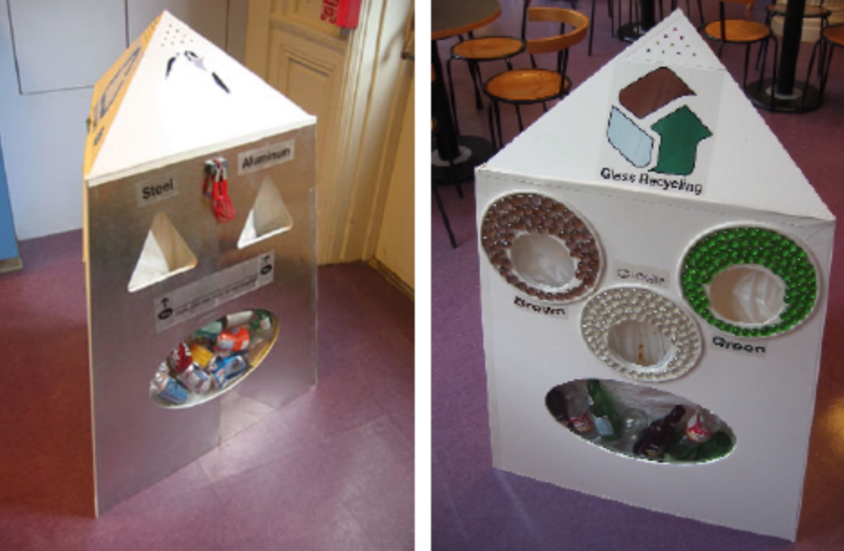
Stage 5: Try
What is the try stage?
Get feedback
Iterate

Slide 35
What is the Try Stage?
Trying is an opportunity to learn about your solution and your user
Observing and listening are key
Learn what works and what doesn’t work
Show, don’t tell
Create experiences
Get feedback
Iterate

Slide 36
Design Thinking is...
...A process
...Everywhere
...Iterative
...Non-Linear
...User-Centered
...Empowering
...Transformative
...A Mindset

Slide 37
Today’s Design Thinking Challenge
How might we design a classroom that supports one or all of the 5 R’s?

Slide 38
Ready, Set, Go!
Yes, we are going through the whole cycle in 1 ½ hours!
Messy
Outside comfort zone
Fun
Real solutions
Teams of 5 people. Find your Space!

Slide 39
Empathize
10 minutes
Think of 2-3 questions
Gather as much information as you can from your “users”
Interview each other
Two minute Interviews
Open-Ended questions (Why? Tell me More…)
Challenge: Learning how to Interview!

Slide 40
Define
15 minutes
Organize your Data and Identify Common Themes
Complete User/Needs/Insight
P.S. We’ve already developed your HMW statement!
Challenge: This is the most challenging stage!

Slide 41
Imagine
10 minutes
Brainstorming!
Defer judgement and get crazy!
Quantity over quality - the more ideas you generate, the better it is!
One idea has to involve a celebrity
Challenge: Thinking too much - fast, fast fast!

Slide 42
Prototype
25 minutes
Make it! Build it!
Challenge: Fail Often, Fail Fast!

Slide 43
Try
2 minute presentation + 1 minute for feedback
Get feedback that informs the next iteration
Create an experience for the user
Show, don’t tell
Challenge: What do you want to know? How will it help to inform your solution?

Slide 44
Shout out!
What was the highlight of your day?
Other Stuff
Evaluation
Lunch
Design Thinking Slides

